Slide 1

Bundelkhand Institute of Engineering and Technology, Jhansi, UP Smart Assistance Glove
GROUP NUMBER 11:- UNDER THE SUPERVISION OF:-
AMRITANSHU YADAV (1904331013) PROF. N. S. BENIWAL
POONAM VERMA (1904331039)
SHUVI VYAS (1904331060)
DEPARTMENT OF ELECTRONICS AND COMMUNICATION ENGINEERING, BIET JHANSI
SESSION 2022-23

Slide 2
Contents
Introduction
Objective
Working
Block Diagram
Components
Limitations
References

Slide 3
Introduction
In India, a recent survey shows that millions of people have speaking and hearing disabilities. The scale goes up to 2.4 million people.
So, the glove we have designed allow the person with disabilities to communicate what they want without anyone's help.
Smart assistance glove is mainly for faster and smarter response.
There are two types of gesture recognition, namely data glove based and vision based.
As vision based recognition is not accurate due to noise disturbance and is difficult to process data. Therefore, data based recognition has been used.

Slide 4
Objective
To enhance human interaction with technology
To provide a seamless interface
To eliminate the need for traditional input devices
To increase safety and efficiency in industrial settings
To improve gaming and entertainment experiences
To facilitate medical procedures

Slide 5
Working
Smart gloves use various sensors to detect the movements and gestures of the wearer's hands and fingers.
The data from the sensors is then processed by a microcontroller, which translates the movements and gestures into digital signals.
The digital signals are transmitted wirelessly to the device or system being controlled, such as a computer, smartphone, or virtual reality headset.

Slide 6
.
The wearer can then use their hands and fingers to control and interact with digital devices and environments.
The smart gloves also provide haptic feedback to the wearer's hands to simulate the sensation of touching or interacting with digital objects.

Slide 7
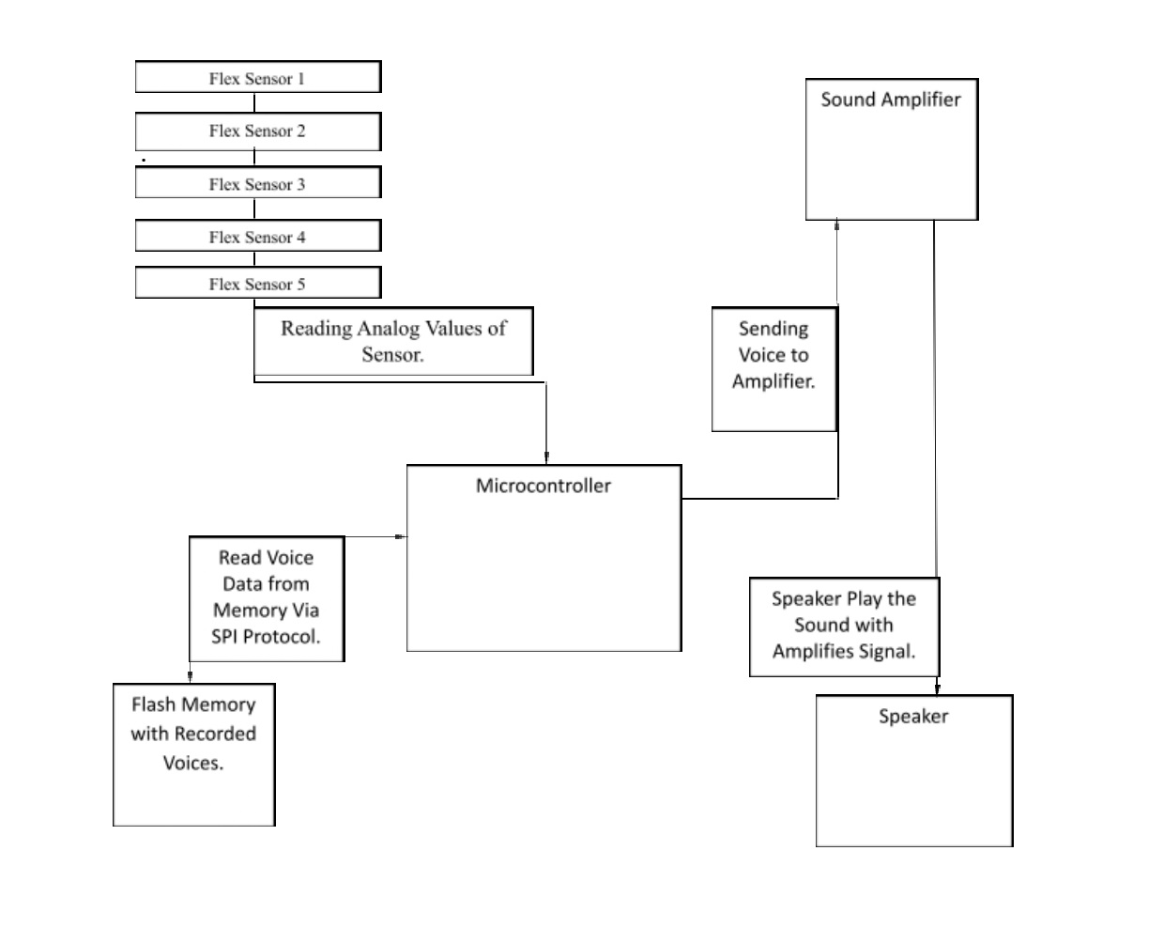
Block Diagram
.

Slide 8
Components
Flex sensors : A flex sensor is a kind of sensor which is used to measure the amount of defection otherwise bending. The designing of this sensor can be done by using materials like plastic and carbon.
Arduino : Arduino is an open-source hardware and software company, project, and user community that designs and manufactures single-board microcontrollers and microcontroller kits for building digital devices.

Slide 9
.
Global System for Mobile communication (GSM) : It is a digital mobile network that is widely used by mobile phone users.
Flash memory : Flash memory is an electronic non-volatile computer memory storage medium that can be electrically erased and reprogrammed. The two main types of flash memory, NOR flash and NAND flash, are named for the NOR and NAND logic gates. Both use the same cell design, consisting of floating gate MOSFETs.

Slide 10
Limitations
Cost
Battery life
Accuracy
User training
Accessibility
Limited functionality

Slide 11
References
Praveen Kumar, S Havalagi and Shruthi Urf Nivedita, ―The Amazing Gloves that give Voice to the Voiceless, International Journal of Advances in Engineering & Technology, Vol. 6, No.1, March 2013.
Gaurav Pradhan , Balakrishnan Prabhakaran and Chuanjun Li, ―Hand-Gesture Computing for the Hearing and Speech Impaired‖ IEEE, Vol.15, No.2, April - June 2008.
S.R.Aarthi Avanthiga and V.Balaji, “A Design Prototypic Sarcastic Gadget Technology for Perceptual Disabilities” International Journal of Recent Technology and Engineering (IJRTE), Vol.2, Issue 6, January 2014.

Slide 12
Thank You

